Slide 1

800V DC in Data Centers
Henrik Nilén

Slide 2
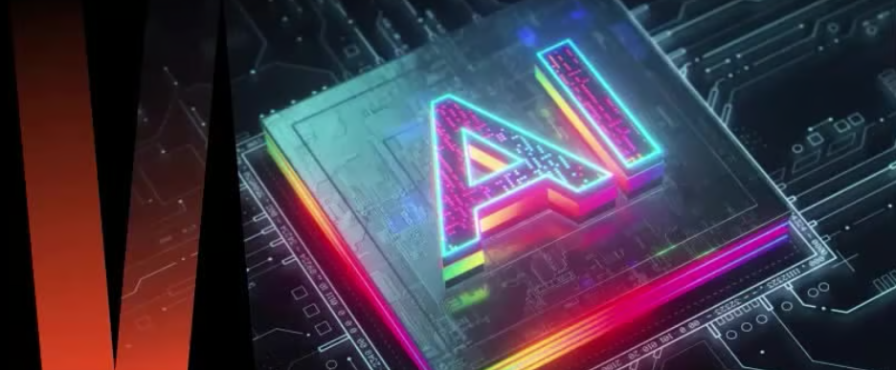
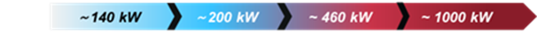
AI - A Paradigm Shift for Data Centers
Compute rack power

Slide 3

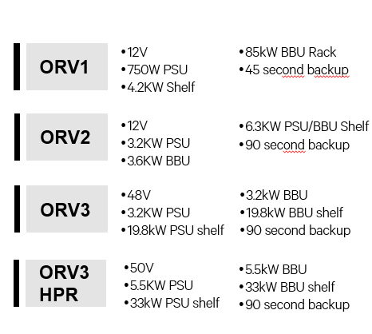
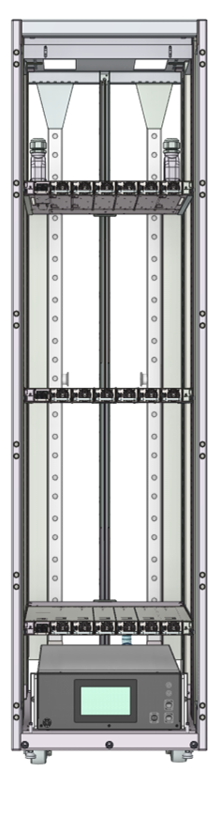
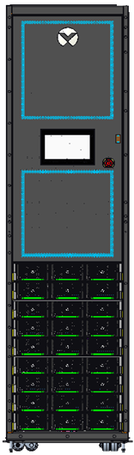
DC Power in the Data Center - Background
DC in the data center started 15 years ago
Driven by hyperscalers and the Open Compute Project
DC power and batteries in each rack gain efficiency and power density
IT
AI servers now drive
Higher power per rack
Increase cables and voltage drop
The answer is 800VDC

Slide 4
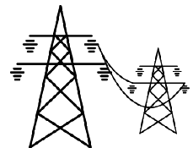
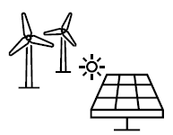
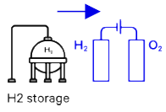
AI Datacenter Power Train Evolution
Power
Battery Backup
Server Rack
Server Shelf
MV/LV
AC UPS
Power shelf
10/13.8/20/34.5kVac
400Vac
400Vac
50Vdc
12V
0.xV
30-250kW/rack (1P PSU)
120-300kW/rack (3P PSU)
Busbar
Chip
Grid
Improve efficiency
Optimize architecture
Power shelf
400Vac
50Vdc
12V
0.xV
Chip
30-140kW/rack
Busbar
No space for BBU&PSU
Rack busbar challenge
Input cable challenge
HVDC (sidecar or centralized)
+/-400Vdc
or
800Vdc
Power shelf
50Vdc
12V
0.xV
Chip
250-600kW/rack
Micro-grid
Busbar
Renewables & Fuel Cells
Rack busbar challenge
Optimize architecture
HVDC Server
800Vdc
50Vdc
0.xV
Chip
250kW～1MW/rack
BESS
Busbar
Improve efficiency
Optimize architecture
Multi energy integration
MVDC Power Center
HVDC Server
MVDC
50Vdc
0.xV
Chip
Busbar
Source: Vertiv 2025

Slide 5











Vertiv Higher Voltage DC Power Footprint
First 240VDC system in the industry was deployed.
The first 400VDC system in the industry deployed in France Telecom.
1st 240V HVDC system in China was launched.
1st generation 400V HVDC system was launched.
2nd generation 240/400V DC system were launched.
3rd 240/400V 25kW rectifier system released.
APT-2.0 DCS system using phase-shifting transformer.
4th generation 240/400V DC system.
5th generation
+/-400VDC
800VDC
system
In August 2019, the prefabricated solution APT-2.0 DC system was launched.
2008 2010 2012 2014 2018 2023 2024 2025

Slide 6
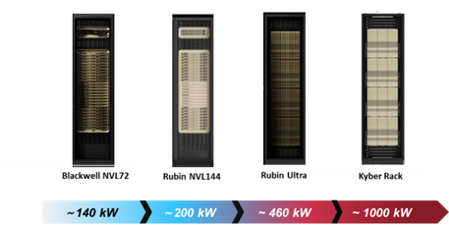
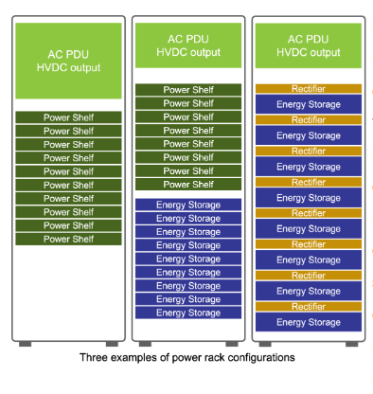
Mt Diablo – An Open Compute +/-400VDC Power Solution
Powering high density AI racks
Leveraging electric vehicle tech
Developed by Microsoft, Meta and Google
Disaggregated sidecar design
Up to 1MW per rack
Includes power, BBU, CBU and distribution
Open source specification

Slide 7
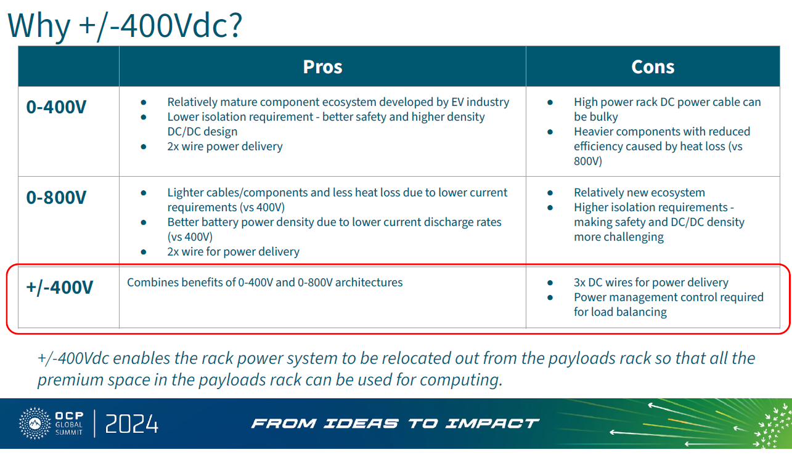
Why CSPs adopt +/-400VDC?

Slide 8
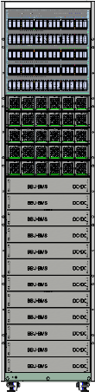
+/- 400VDC Solution
AC Input
DC Output
+400VDC
0
-400VDC
AC & DC
PDU
400/50
DCDC
400/50
DCDC
800/50
DCDC
800VDC
Busbar
50VC
server
50VDC server
50VDC server
800VDC server
PSU
BBU+CBU
Server Rack
Server Rack
Server Rack
Server Rack

Slide 9
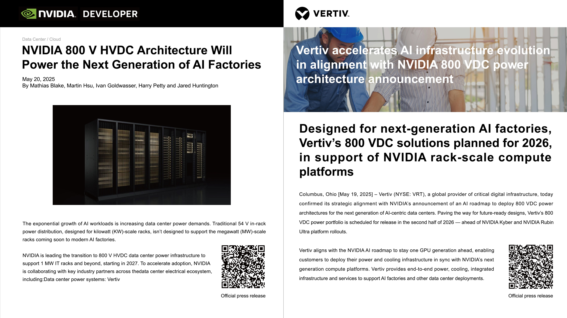
NVIDIA 800VDC Architecture
54V DC Limits: Space constraints, Copper overload, Inefficient conversion steps
800V DC benefits: Scalability, Efficiency, Copper reduction, Reliability, Future-proofing
Key numbers: 800VDC → 5% efficiency gain, 70% maintenance cost reduction

Slide 10
Conclusions
AI servers demand lots of power. 1MW per compute racks in a few years
Space constraints, copper overload and voltage drop drive towards higher voltage power systems
Disaggregated power is a trend. First sidecar in white space, later in grey space
Native 800VDC servers will help reduce power losses
The future will bring even higher voltage solutions

Slide 12
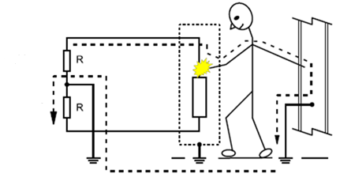
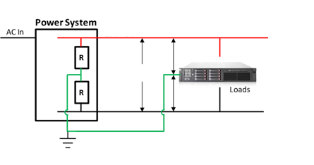
High Resistance Midpoint Grounding Concept
High Resistance Mid-Point Grounding (HRMG, GFD required)
High resistance midpoint grounding (HRMG) makes 800V DC safe with regard to electrical shock (line to ground type) with the limitation of human body current for line to ground (7.5mA for 110kOhm each resistor, IEC Zone II)
No arc flash to ground during single ground fault utilizing HRMG
Ground fault detect (GFD)
Ground fault detect(GFD) module equipped with an insulation resistance measuring circuit to check the resistance between 800V, Rtn and PE.
GFD module also applies switching resistor topology to calculate the symmetrical ground fault.
800V DC
800V DC
+400V
800V
-400V
Rtn
Rtn
Hi-resistance mid-point grounding scheme
12

Slide 13
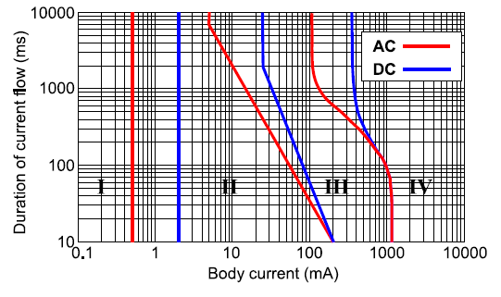
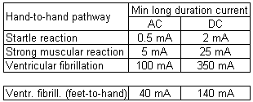
Health and Safety
800VDC
midpoint 50kΩ - II
400VDC direct midpoint - III
400VDC
midpoint 50kΩ - II
48VDC - II
120VAC - III
230/277VAC - IV
800VDC direct midpoint – III
I - Normally no perception
II - No dangerous physiological
effect, risk of startle reaction
III - Risk of muscular reaction
IV - Critical effects, risk of
ventricular fibrillation
400VDC (one pole) – III
800VDC (one pole) – IV
RCD 30mA/200ms
Average human body resistance =1500 ohm (200-400V)
RCD –residual current device (in US and Canada also known as GFI or GFCI)

